Slide 1

March 26, 2024
Congjian Wang
Platform of Optimal Experiment Management
(POEM)

Slide 2
Tool: Optimal Experimental Design Platform
Optimal experimental design platform powered with automated machine learning to accelerate the discovery of optimal solutions, and automatically guide the design of experiment to be evaluated.
Design parameter optimization with multiple objectives
Aims at improving the sample efficiency of optimization problems, i.e., using less number of samples to achieve the best performance, by applying state-of-the-art machine learning approaches.
Determining where to obtain new data in order to build accurate models
Dynamic sensitivity and uncertainty analysis
Model calibration through Bayesian inference

Slide 3
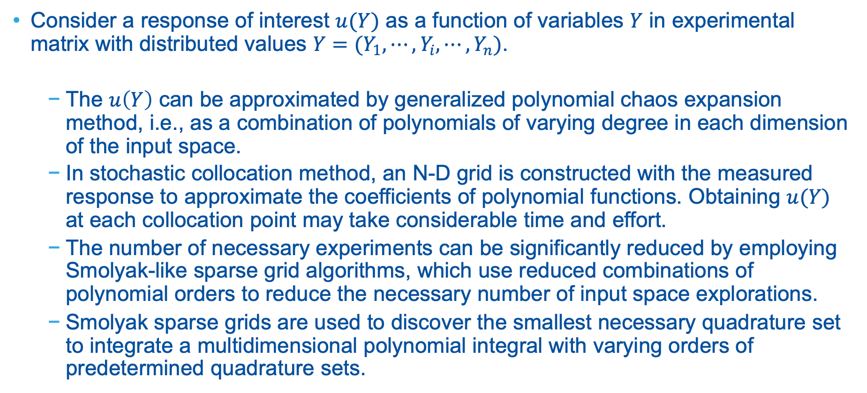
Accelerate DOE via Sparse Grid Stochastic Collocation
Consider a response of interest $u(Y)$ as a function of variables $Y$ in experimental matrix with distributed values $Y=(Y_{1},⋯,Y_{i},⋯,Y_{n})$.
The $u\left(Y\right)$ can be approximated by generalized polynomial chaos expansion method, i.e., as a combination of polynomials of varying degree in each dimension of the input space.
In stochastic collocation method, an N-D grid is constructed with the measured response to approximate the coefficients of polynomial functions. Obtaining $u(Y)$ at each collocation point may take considerable time and effort.
The number of necessary experiments can be significantly reduced by employing Smolyak-like sparse grid algorithms, which use reduced combinations of polynomial orders to reduce the necessary number of input space explorations.
Smolyak sparse grids are used to discover the smallest necessary quadrature set to integrate a multidimensional polynomial integral with varying orders of predetermined quadrature sets.

Slide 4
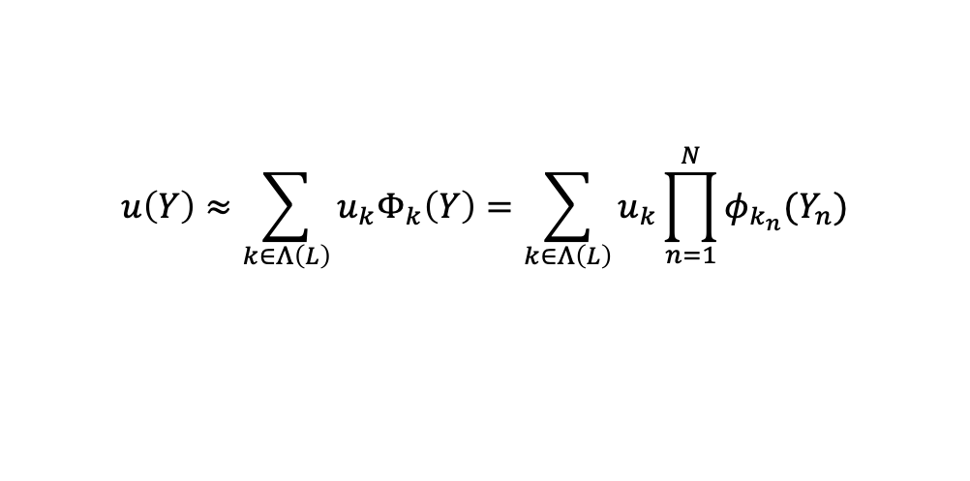
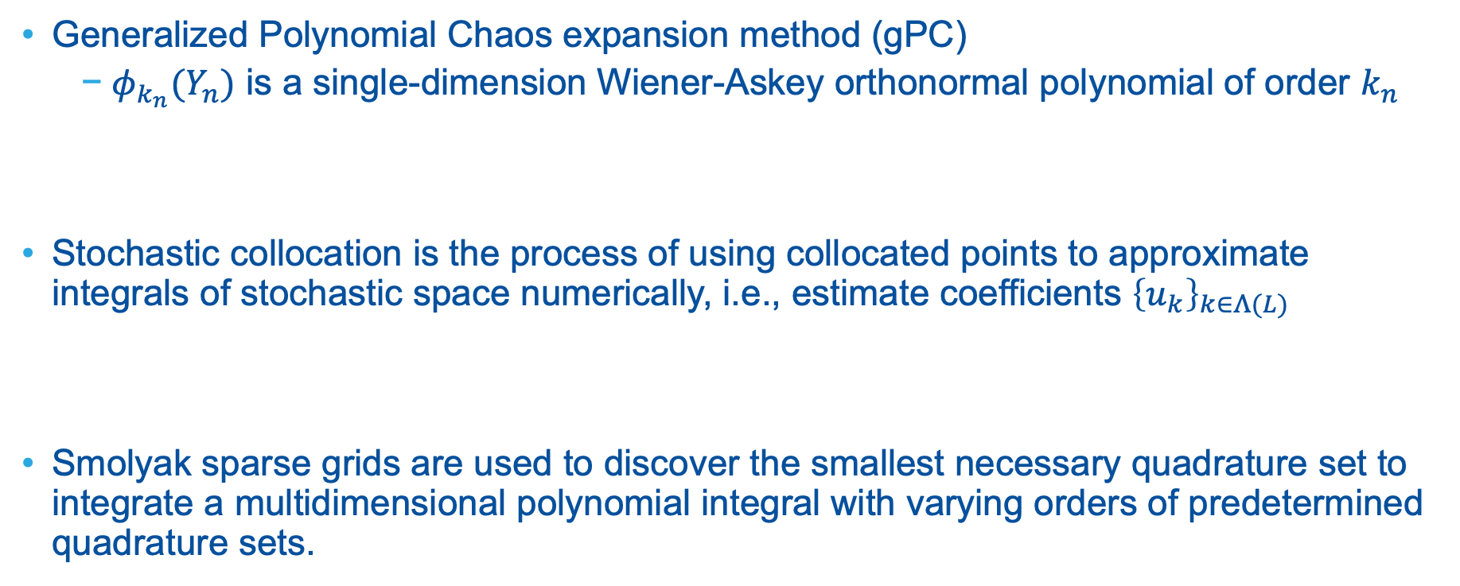

Accelerate DOE via Sparse Grid Stochastic Collocation
Generalized Polynomial Chaos expansion method (gPC)
$φ_{k_{n}}(Y_{n})$ is a single-dimension Wiener-Askey orthonormal polynomial of order $k_{n}$
Stochastic collocation is the process of using collocated points to approximate integrals of stochastic space numerically, i.e., estimate coefficients ${\left\{u_{k}\right\}}_{k∈Λ(L)}$
Smolyak sparse grids are used to discover the smallest necessary quadrature set to integrate a multidimensional polynomial integral with varying orders of predetermined quadrature sets.
$$u\left(Y\right)≈\sum_{k∈Λ\left(L\right)}{u_{k}Φ_{k}\left(Y\right)}=\sum_{k∈Λ\left(L\right)}{u_{k}\prod_{n=1}^{N}{φ_{k_{n}}(Y_{n})}}$$
$$u_{k}=\frac{\left\langle u\left(Y\right){, Φ}_{k}(Y)\right\rangle }{\left\langle Φ_{k}\left(Y\right), Φ_{k}(Y)\right\rangle }$$

Slide 5
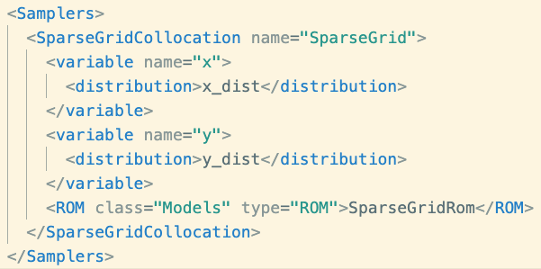
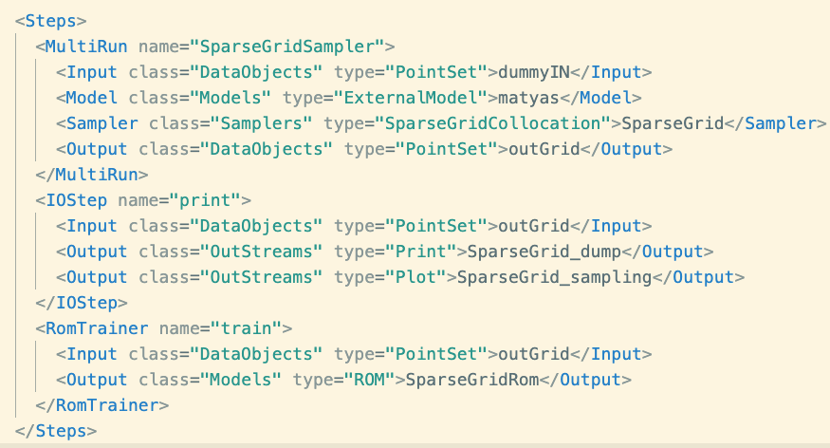
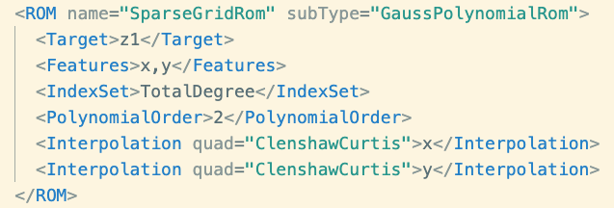
Generate Sparse Grid
Sparse Grid Sampler to generate sparse grid
Train gPC ROM
Save data
Plot data

Slide 6
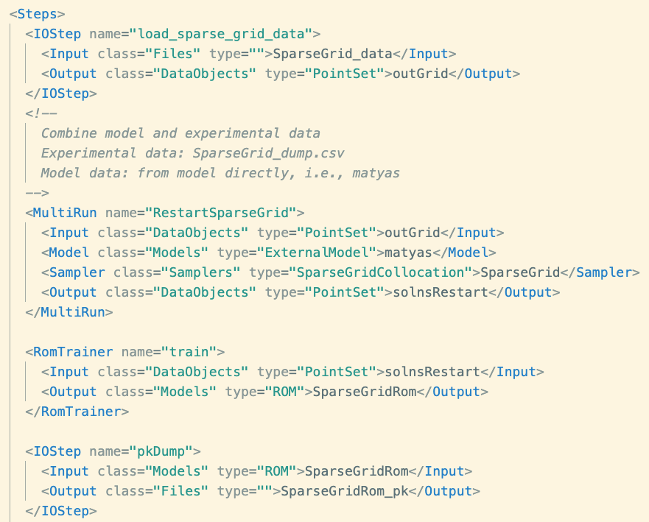
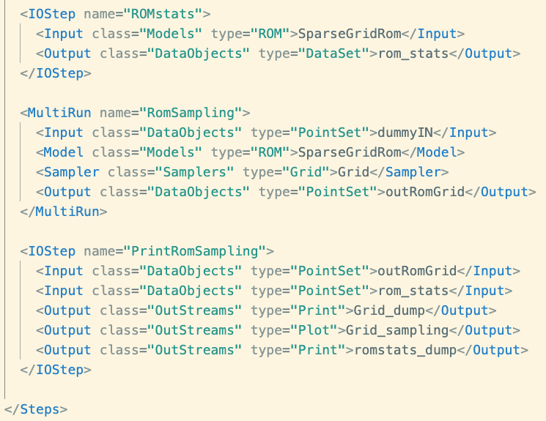
Generalized Polynomial Chaos Expansion Training

Slide 7
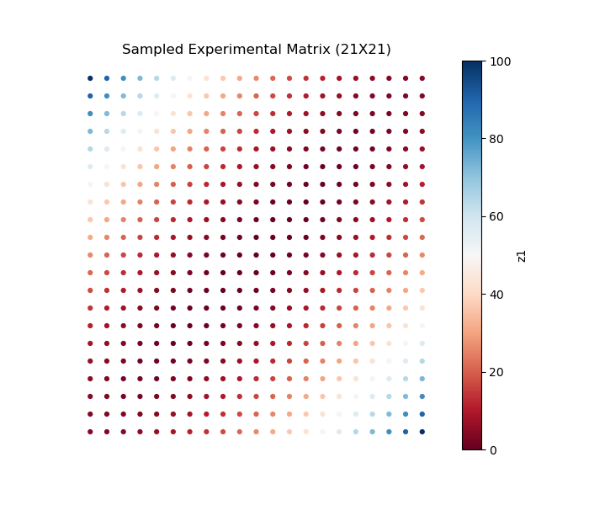
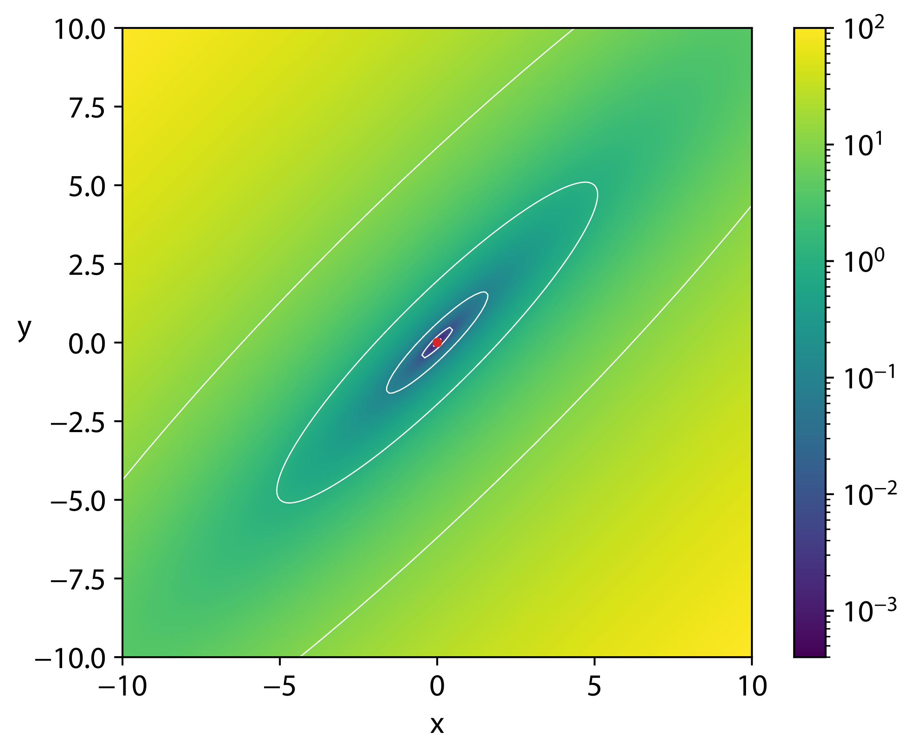
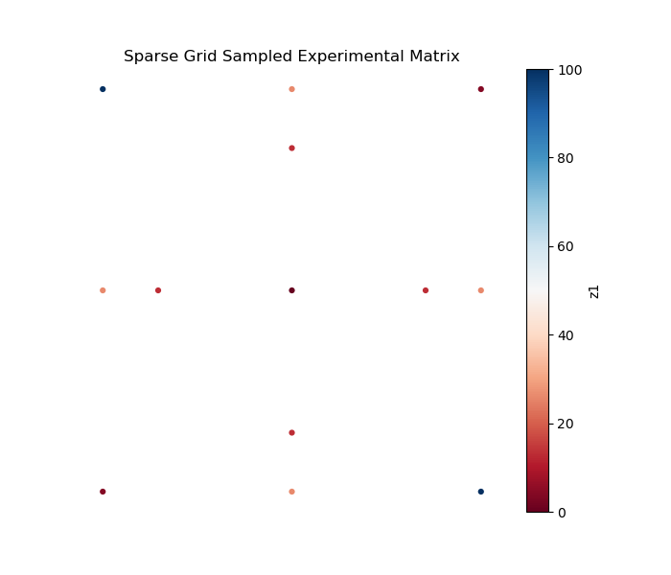
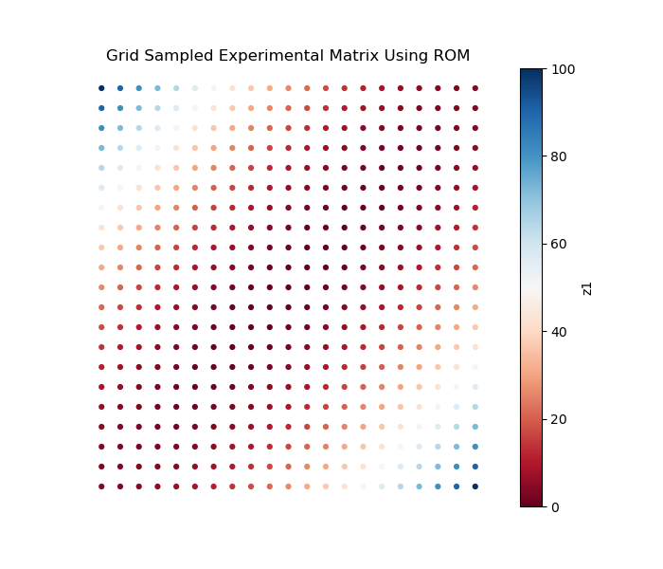
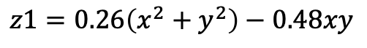
Accelerate Experimental Design: Matyas Function
$$z1=0.26\left(x^{2}+y^{2}\right)−0.48xy$$
High-Fidelity Simulation
Grid
Sampling
ROM Simulation
Sparse Grid Collocation
Generalized Polynomial Chaos
ROM
Simulation data at sparse grid locations
Conduct experiment at sparse grid locations
Combine both data for ROM construction
Grid
Sampling

Slide 8
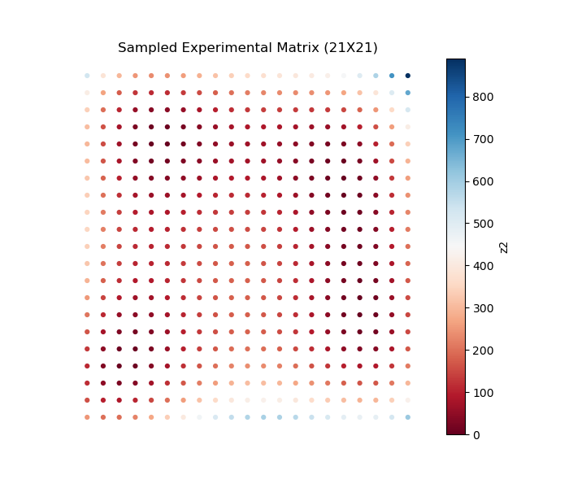
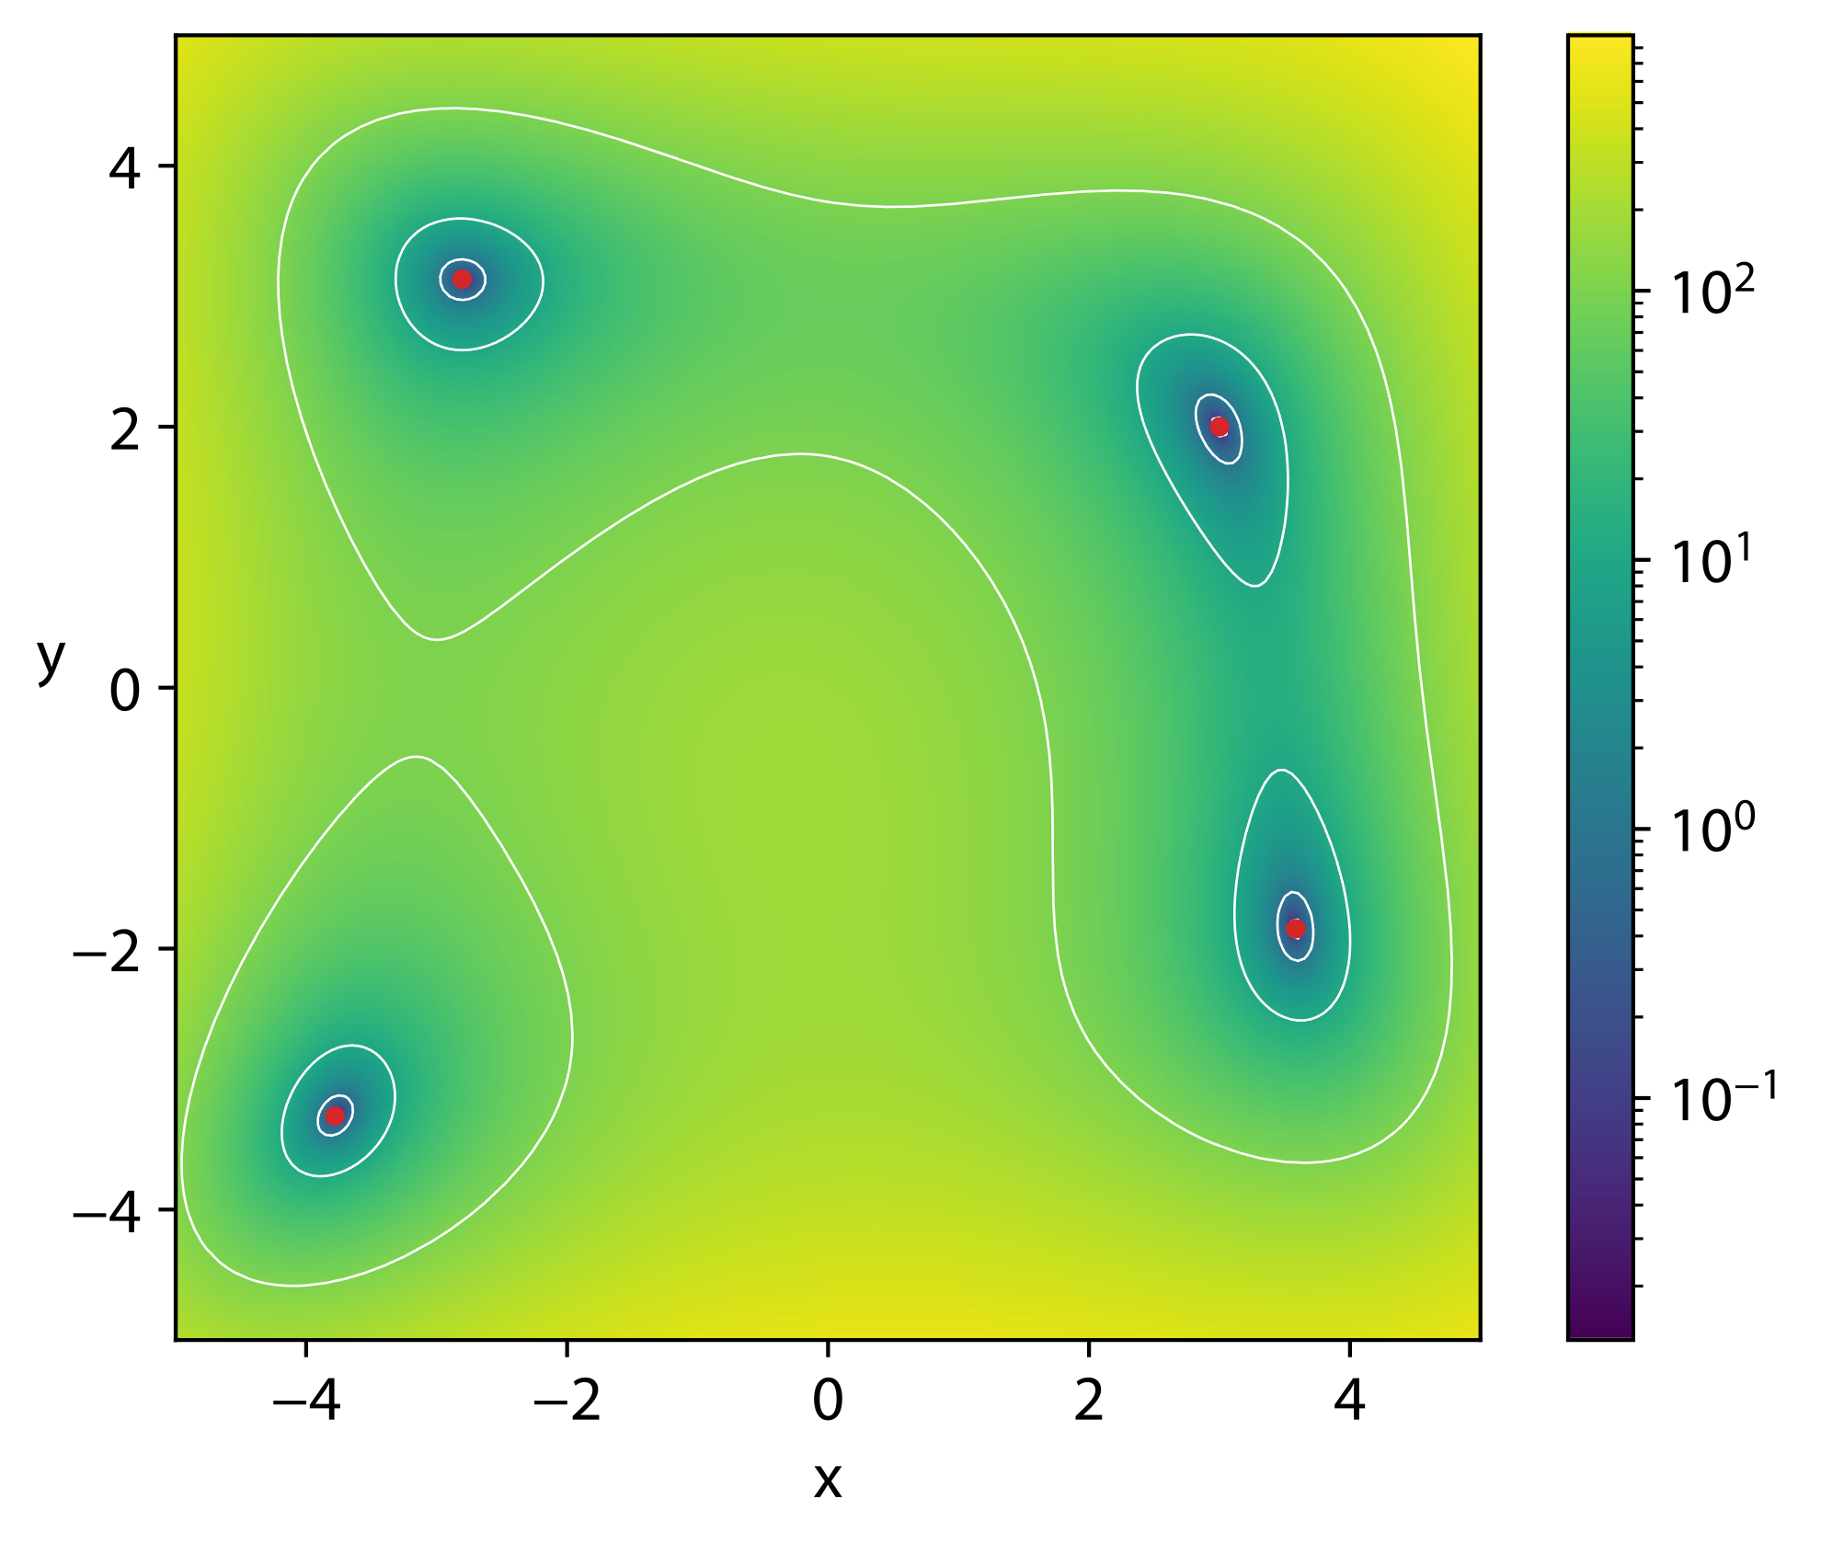
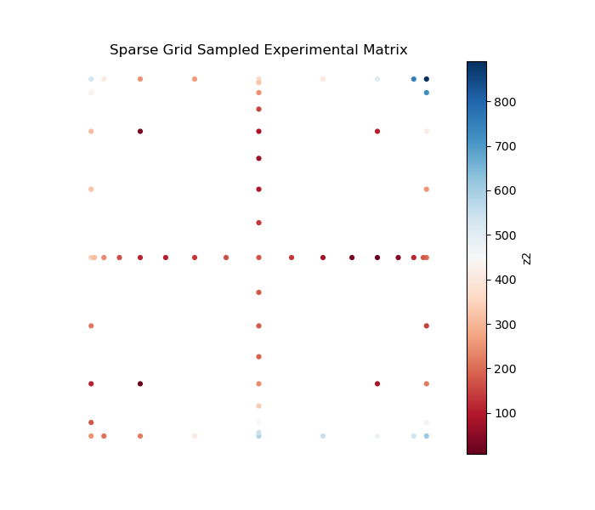
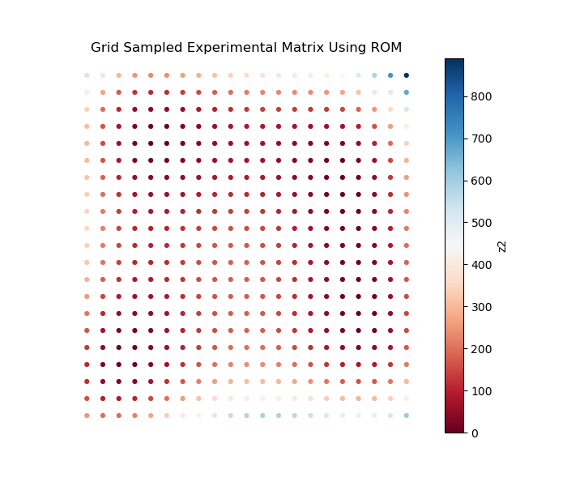
Accelerate Experimental Design: Himmelblau Function
$$z2={\left(x^{2}+y−11\right)}^{2}+{\left(x+y^{2}−7\right)}^{2}$$
High-Fidelity Simulation
Grid
Sampling
ROM Simulation
Sparse Grid Collocation
Generalized Polynomial Chaos
ROM
Simulation data at sparse grid locations
Conduct experiment at sparse grid locations
Combine both data for ROM construction
Grid
Sampling

Slide 9
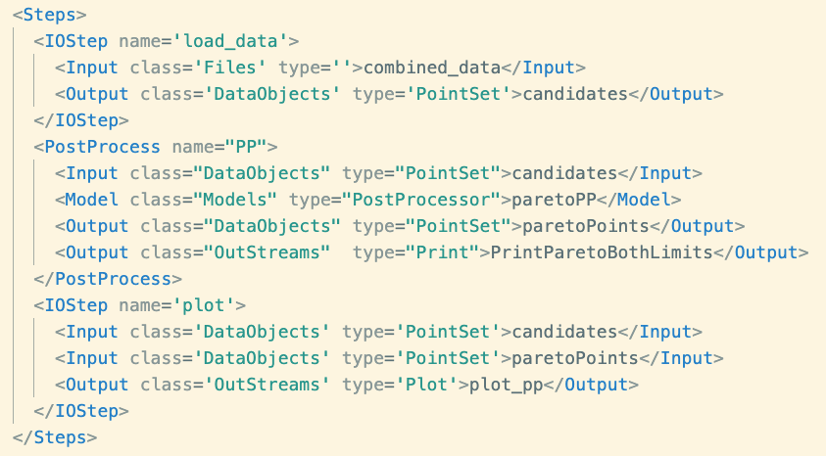
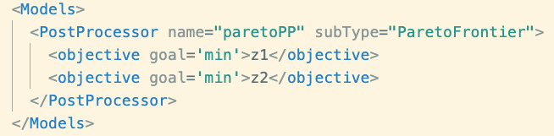
Pareto Frontier

Slide 10
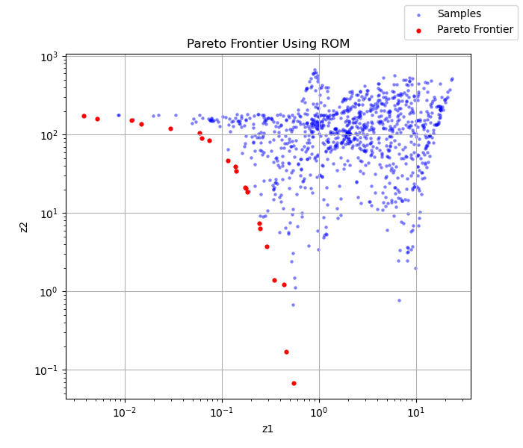
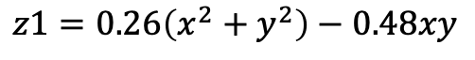
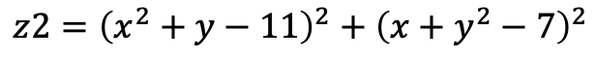
Accelerate Experimental Design: Pareto Frontier
$$z2={\left(x^{2}+y−11\right)}^{2}+{\left(x+y^{2}−7\right)}^{2}$$
$$z1=0.26\left(x^{2}+y^{2}\right)−0.48xy$$

Slide 11
ROM and Suggestions via Bayesian Optimization
Utilize Bayesian optimization structure to exploit the experimental space
Exploit and explore
Bayesian Optimization
Experimental data
Machine learning
Acquisition function
Best sample
Evaluate simulation
Gaussian process
Probability of improvement
Expected improvement
Upper confidence bound
High-fidelity model
Inner evaluations
Evaluate experiments
Proposed best experiments
Outer evaluations

Slide 12
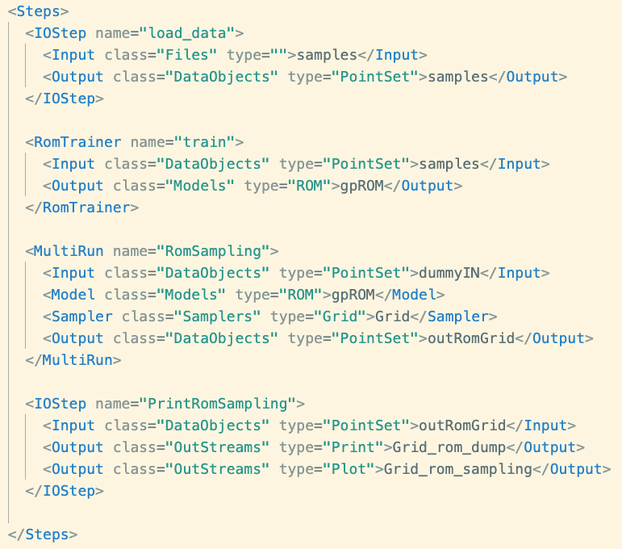
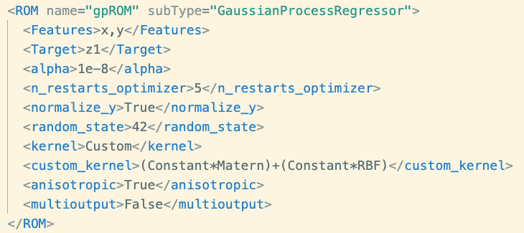
Gaussian Process Regressor ROM Training
Load experimental data
Train gPC ROM
Resample gPC ROM
Save data
Plot data

Slide 13
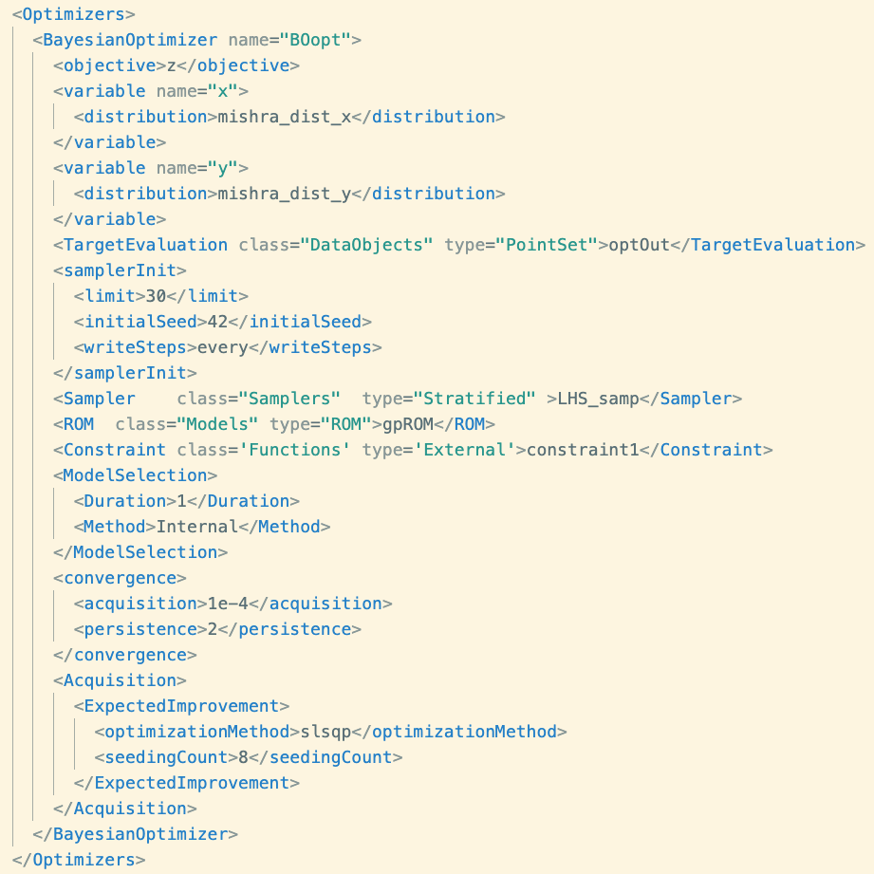
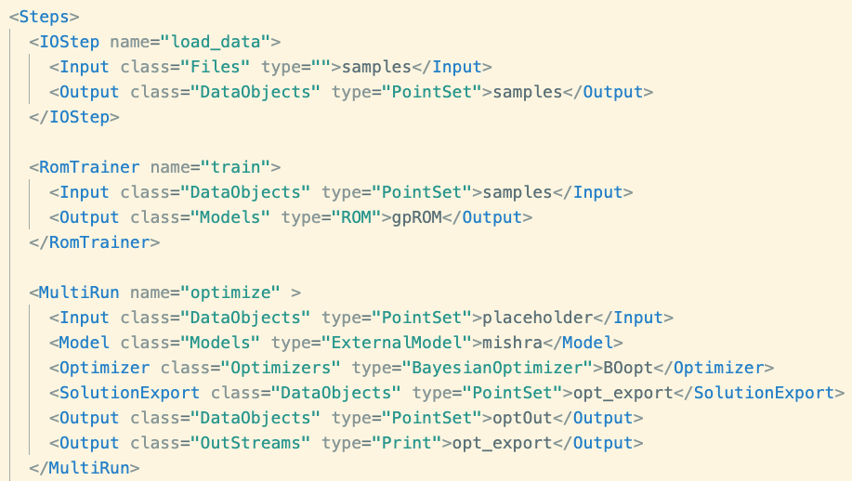
Bayesian Optimization with GP ROM
Proposed best experiments

Slide 14
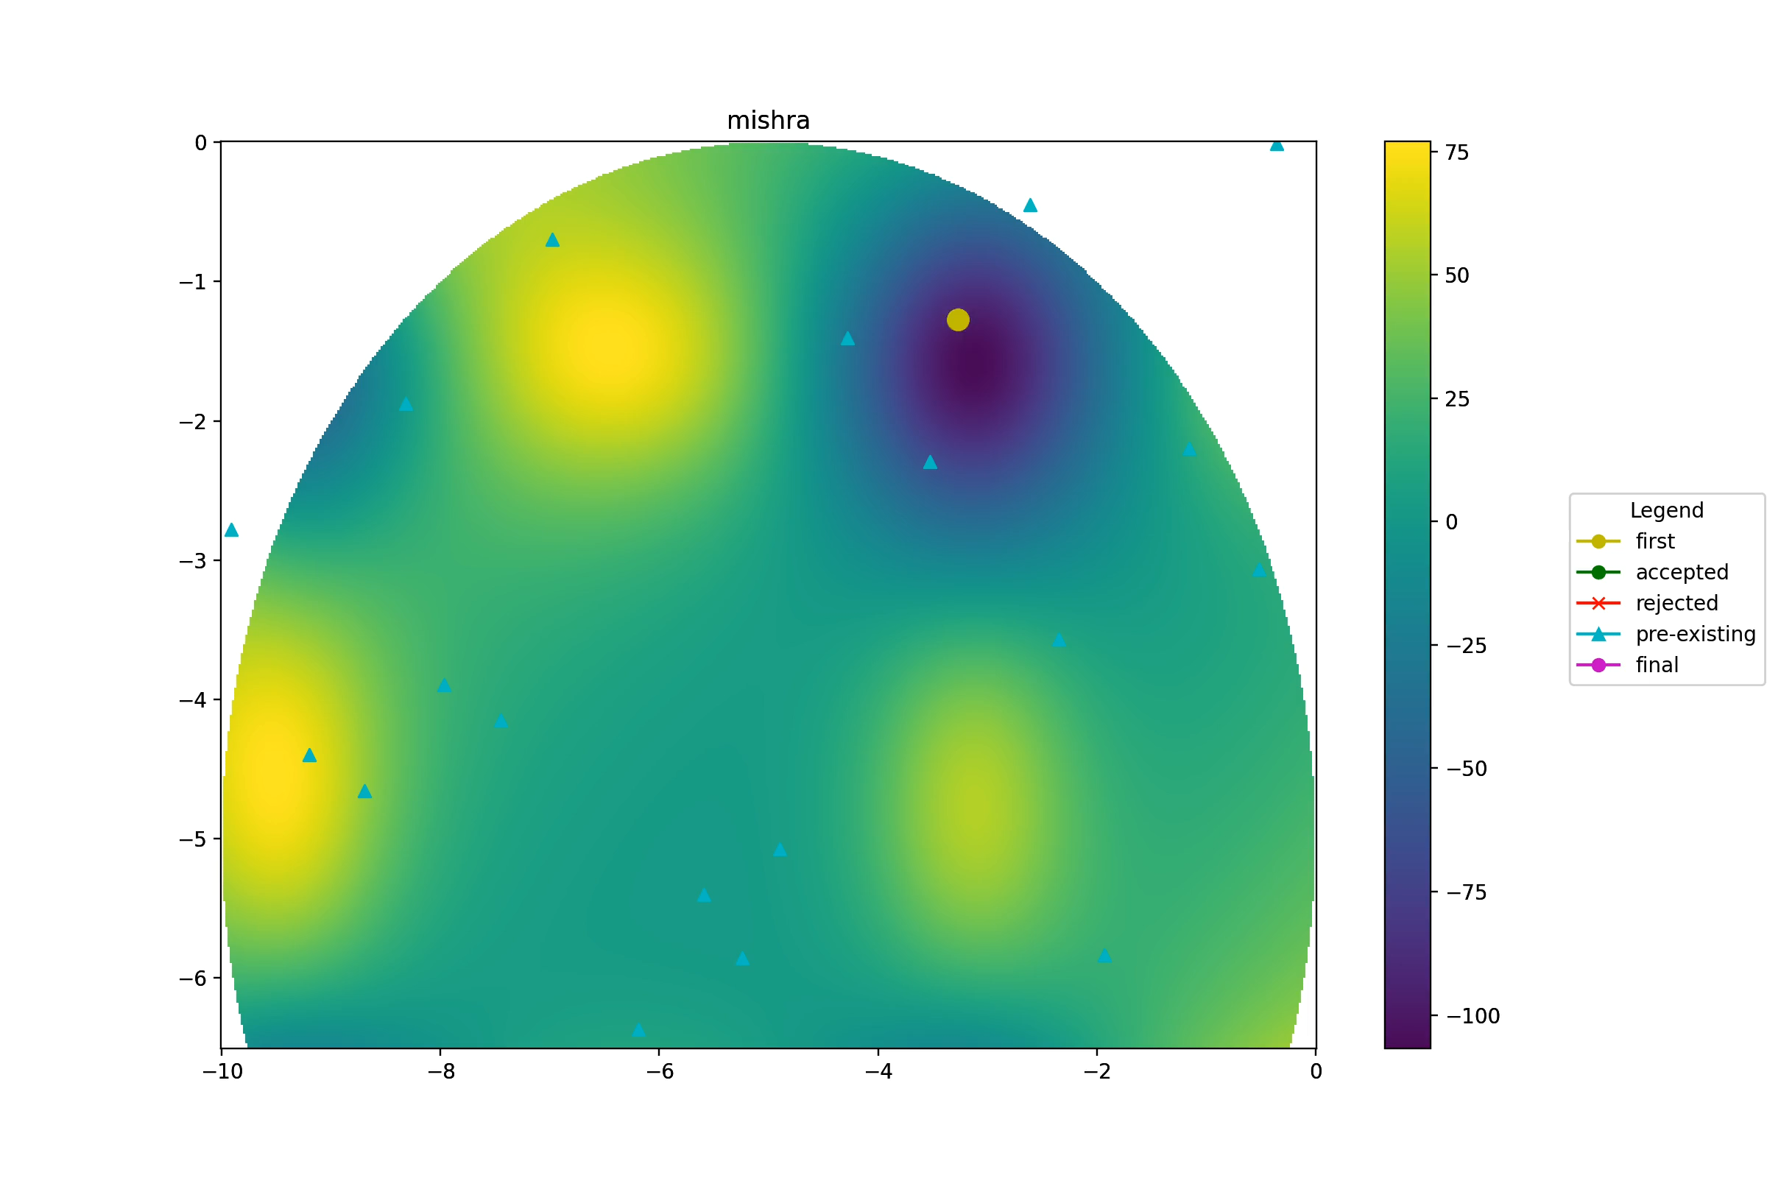
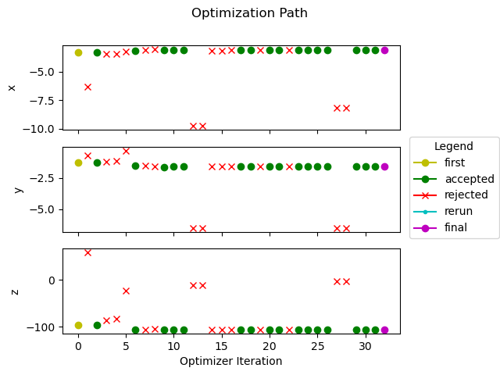
Bayesian Optimization with Constraints

Slide 15
Model Calibration
Bayesian Model Calibration (https://github.com/idaholab/BayCal)
BayCal toolkit is a software plugin for Risk Analysis Virtual Environment (RAVEN), arming at inversely quantifying the uncertainties associated with simulation model parameters based on available experiment data. BayCal seeks statistical inference of the uncertain input parameters that are consistent with the available measurement data or observed data. The unique feature of BayCal is the capability to be linked with RAVEN to build corresponding calibration workflows for complex multi-physics simulations.
BayCal trys to resolve two critical issues existing in the Bayesian inference: 1) high-dimensional experimental data (such as time series observations at multiple locations), 2) expensive computational simulations. BayCal automatizes the process by coupling with RAVEN, utilizes artificial intelligence algorithms to automatically construct surrogate models for the expensive computational simulations and dimensionality reduction techniques to significantly reduce the number of simulations for convergence.

Slide 16
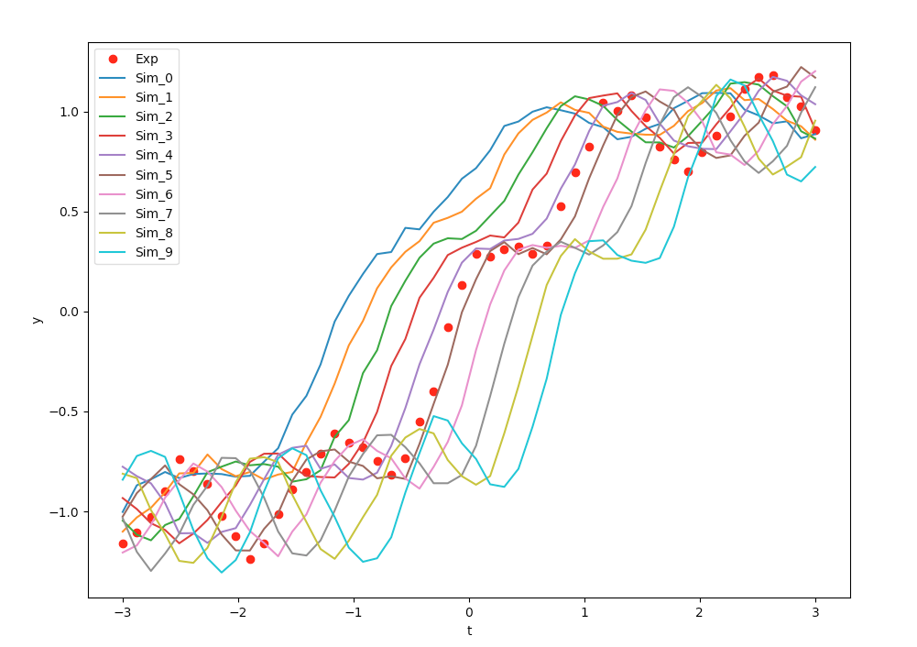
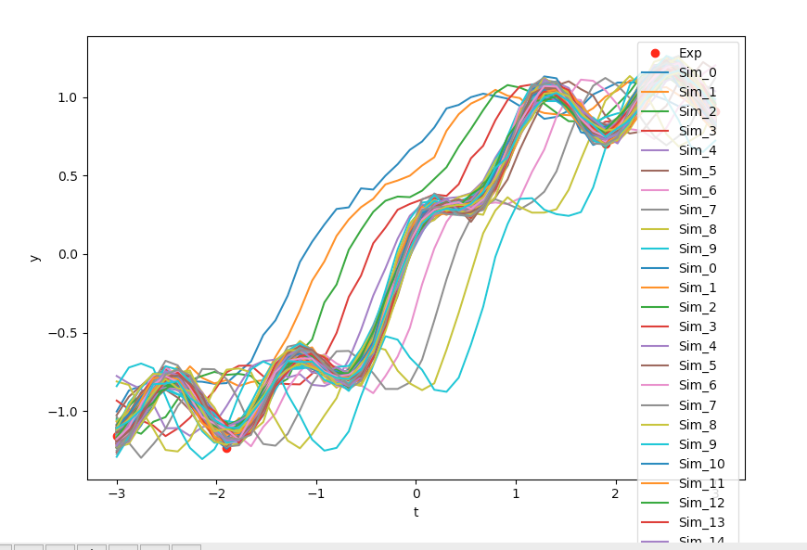
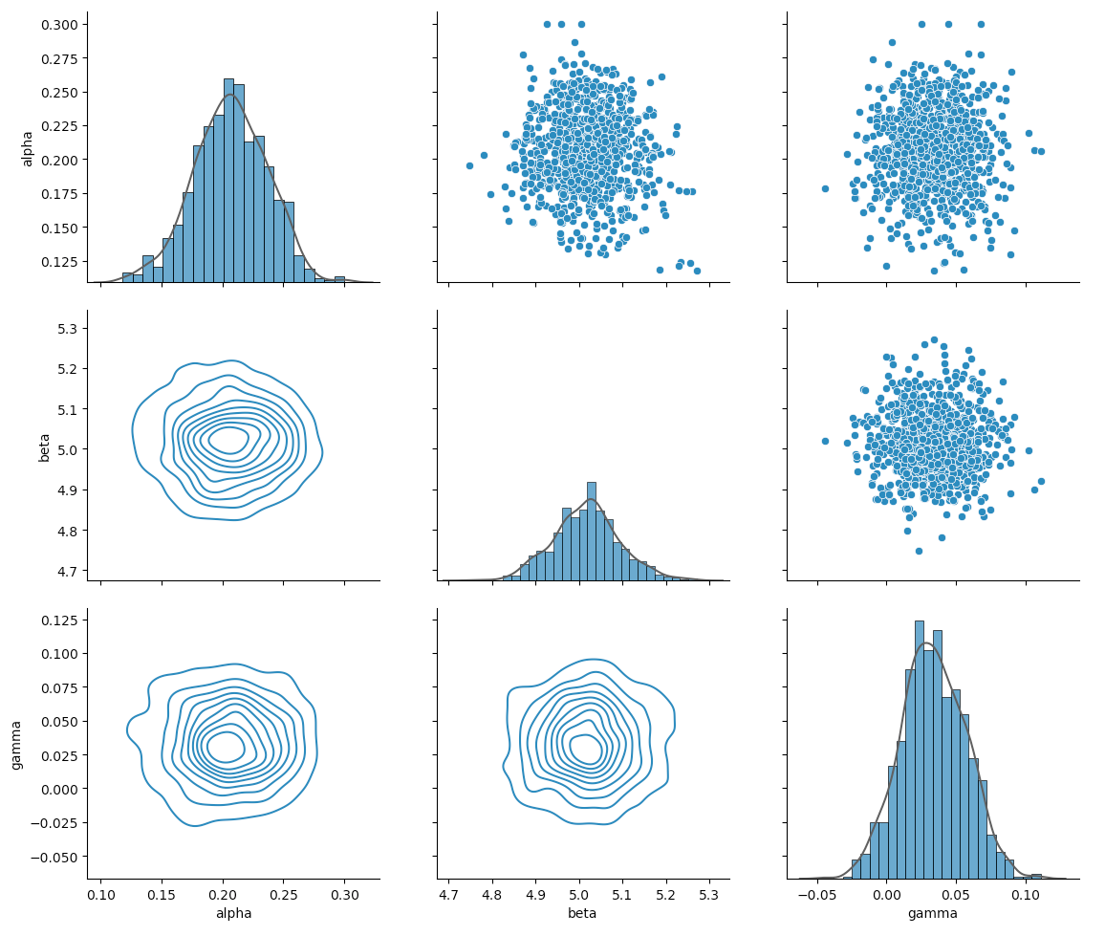
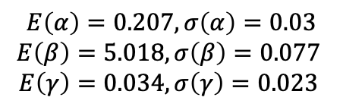

Prior Simulations
Posterior Simulations
Prior: uniform distribution
$$α∈[0.1, 0.3]$$
$$β∈[4.0, 5.0]$$
$$γ∈[−1.0, 1.0]$$
Posterior distribution
$$E\left(α\right)=0.207, σ\left(α\right)=0.03$$
$$E\left(β\right)=5.018, σ\left(β\right)=0.077$$
$$E\left(γ\right)=0.034, σ\left(γ\right)=0.023$$
Real Model for Experimental Data Generation (Red Dots)
$$y_{Exp}=\tanh\left(t−γ\right)+α\cos\left[β\left(t−γ\right)\right]+0.05\sin\left(5.0t\right)+ε_{y}$$
Posterior Distribution
$$ε_{y}∈N\left(0, 0.04\right)$$
$$α=0.2, β=5.0, γ=0.$$
Simulation Model
$$y_{Sim}=\tanh\left(t−γ\right)+α\cos\left[β\left(t−γ\right)\right]+ε_{η}$$
$$ε_{y}∈N\left(0, 0.02\right)$$
$$α∈[0.1, 0.3], β∈[4.0, 5.0], γ∈[−1.0, 1.0]$$

Slide 17
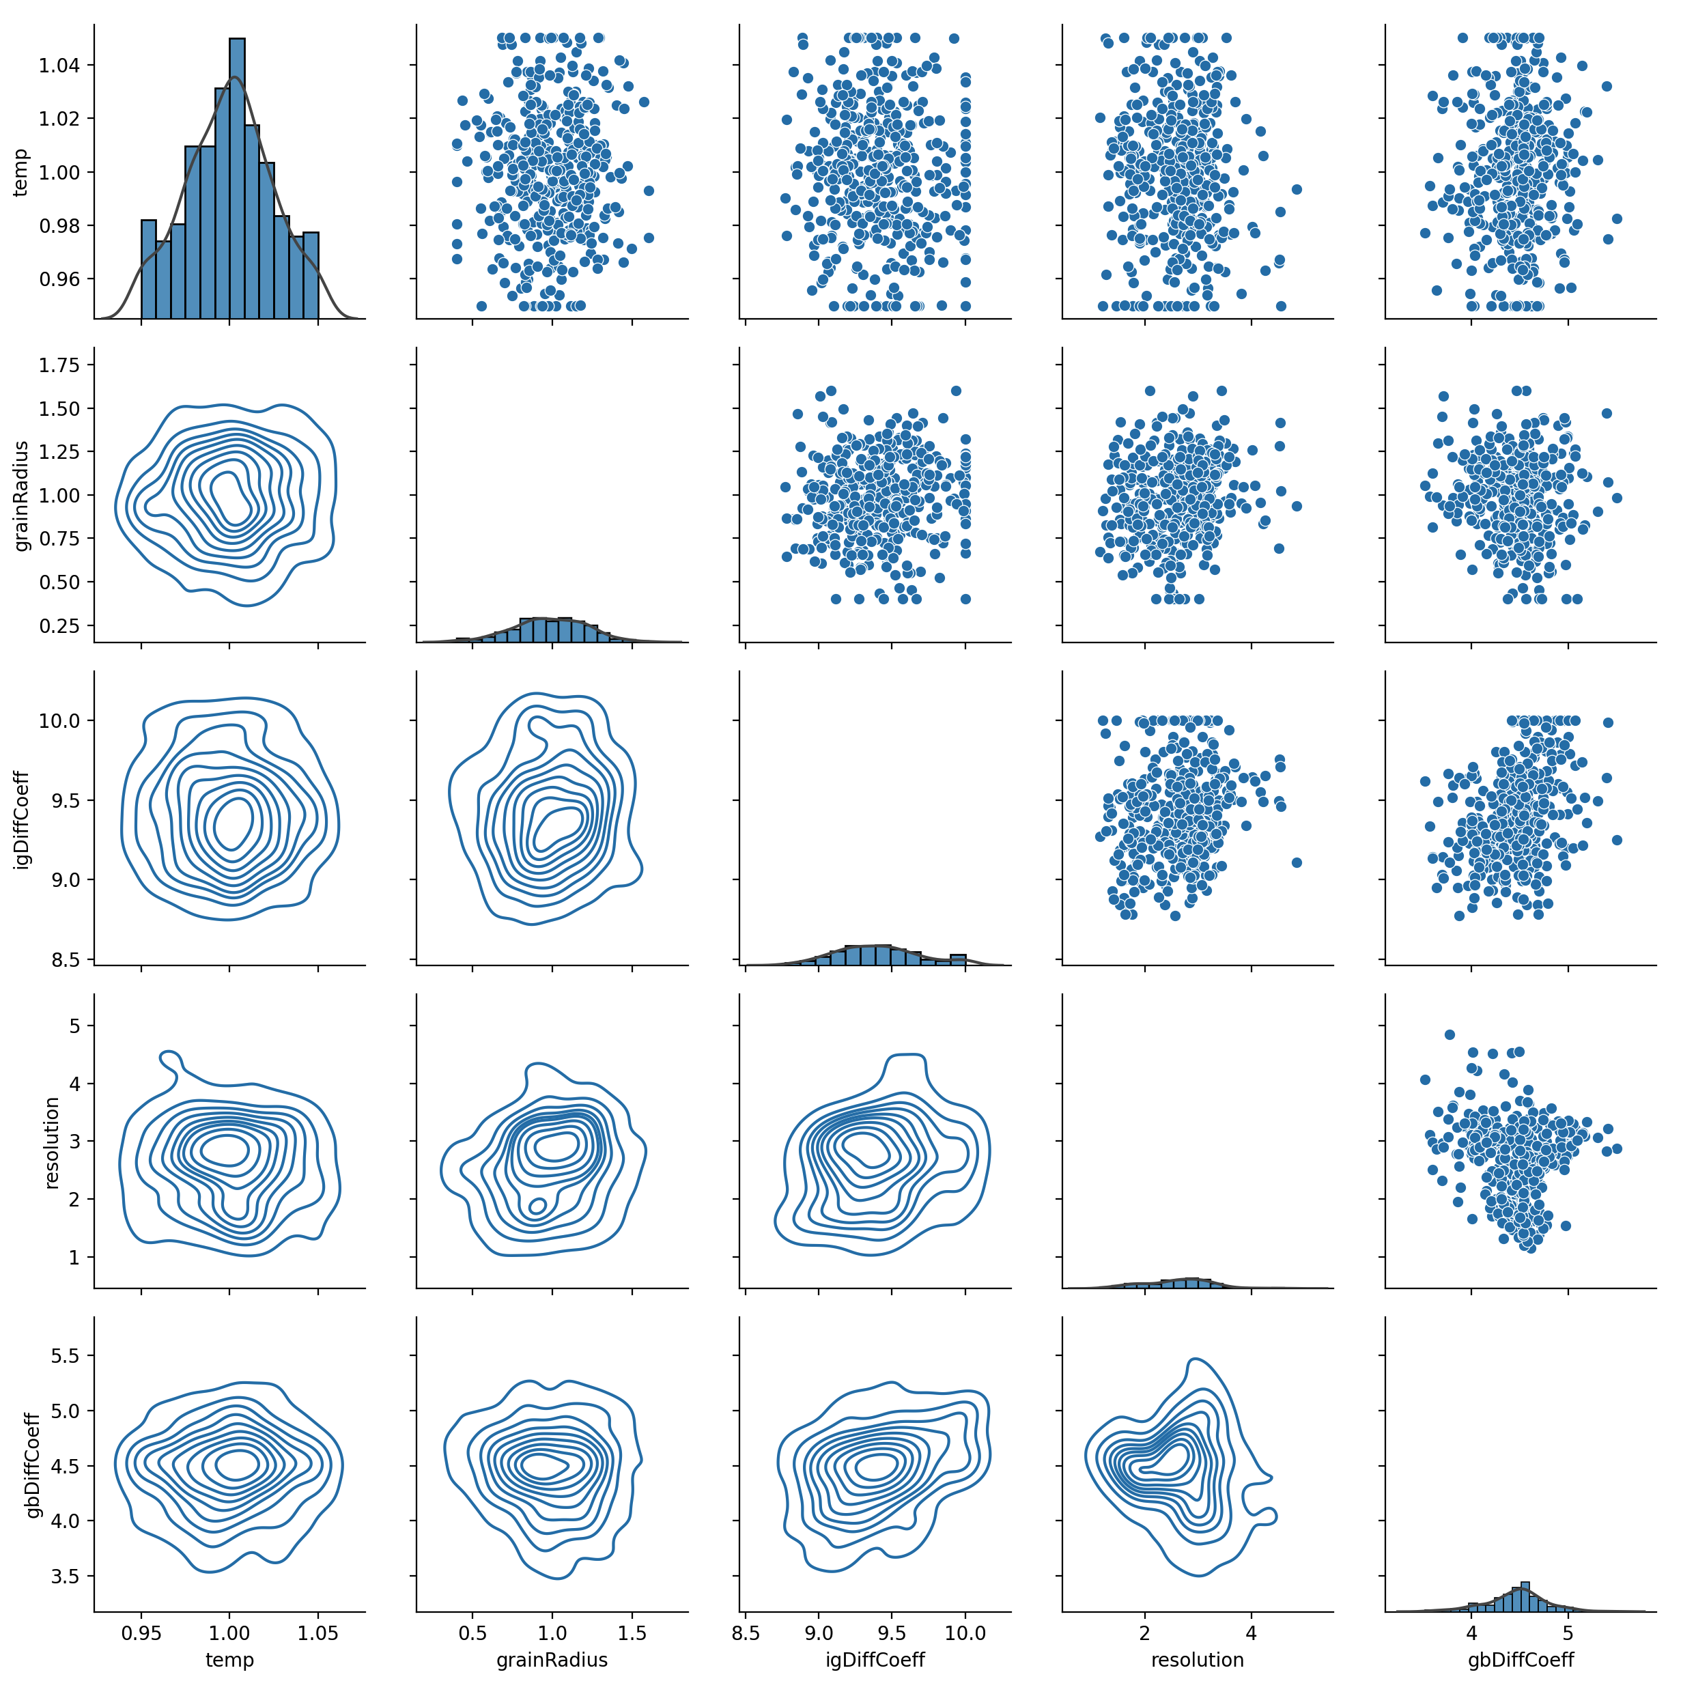
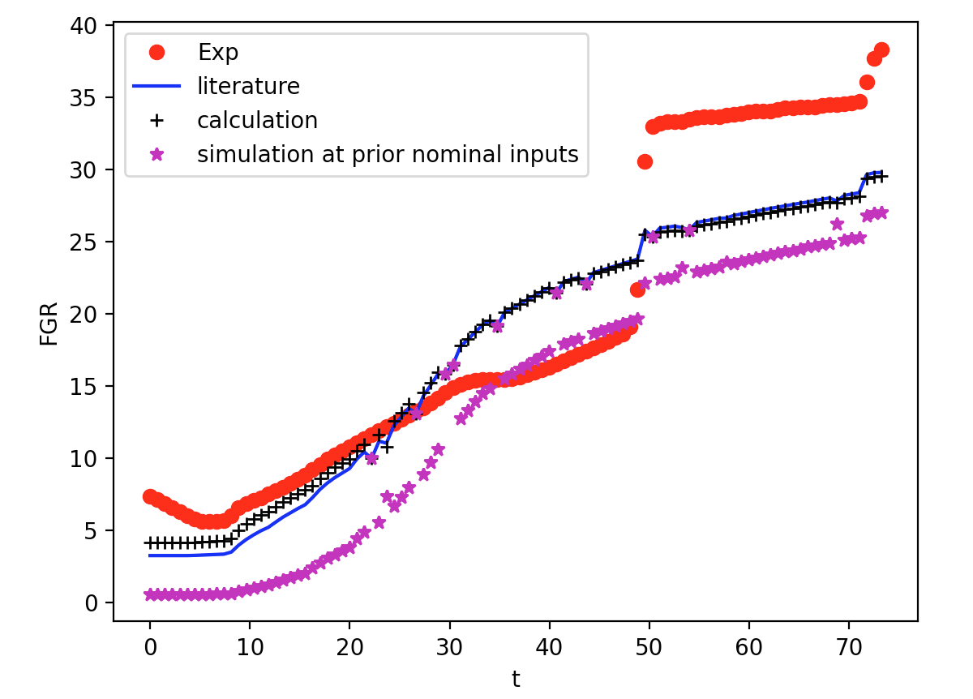
Model Calibration: Fission Gas Release Model

Slide 18
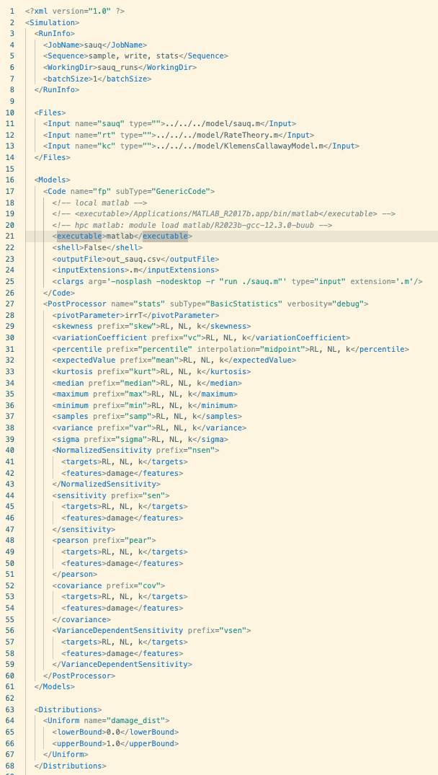
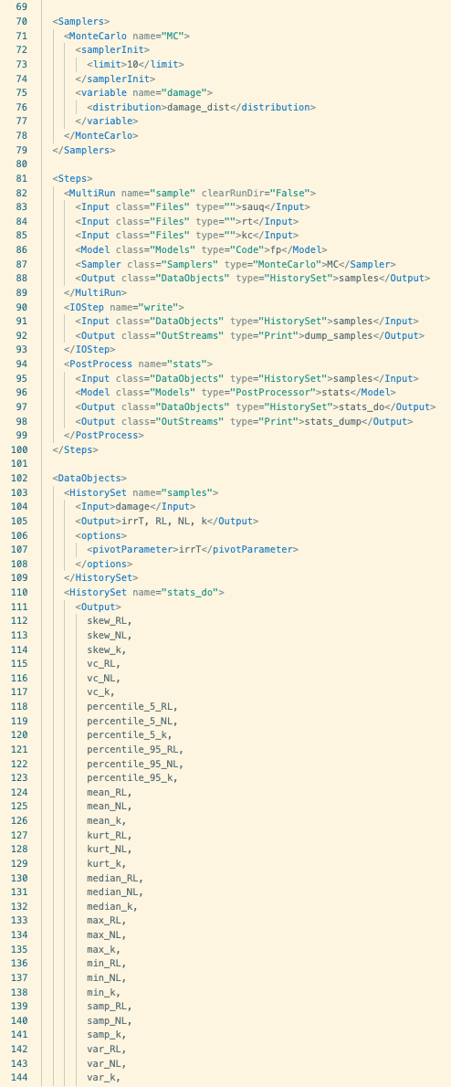
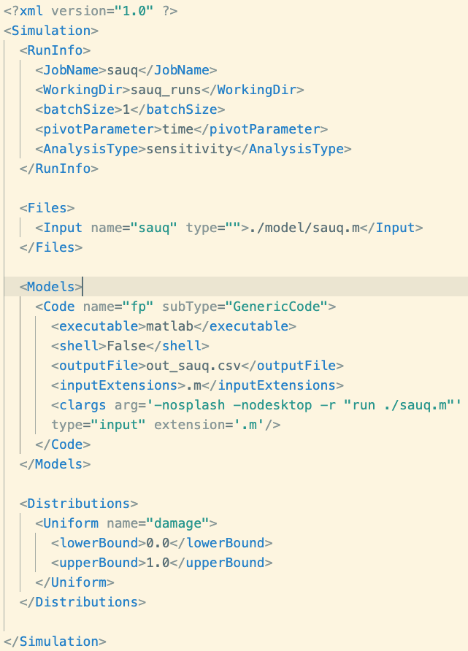
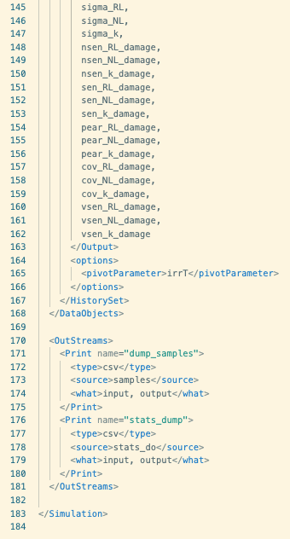
Workflow Templates
POEM Input File
RAVEN Input File

Slide 19
POEM DEMO

Slide 20
Tasks Discussion
Bayesian calibration
Workflow template/GUI
Documentation
Software disclosure
Modeling/model coupling

